Slide 1
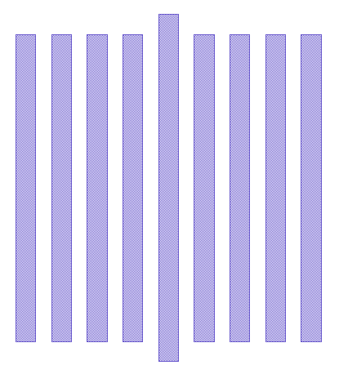





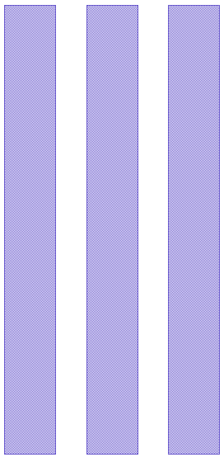


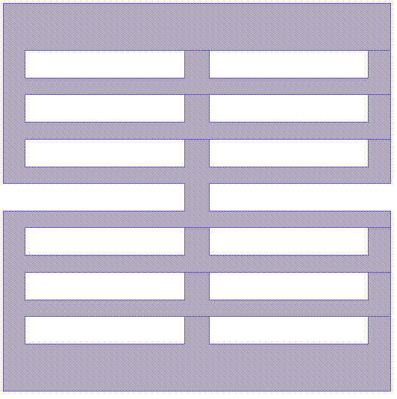



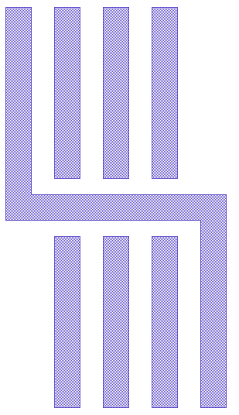
FAB1 SIEMENS OPC Model용 Test Pattern Inform
Pitch Line Linearity (PL) | Pitch Space Linearity (PS) | ISO Line Linearity (IL) | ISO Space Linearity (IS) | BIG MAC (BM) | 2BAR
3BAR | ISO Line-End (ILE) | Dense Line-End (DLE) | INV_ISO Line-End | INV_Dense Line-End | Center Line ISO Line-End (CTILE)
Center Line Dense Line-End (CTDLE) | Center Line 1-BAR (CL1B) | Center Line 3-BAR (3) | ISLAND | INV-ISLAND
#1 Shot | AA | GC | M1 | Inter-Metal
PL | 552 | 672 | 837 | 621
PS | 525 | 651 | 837 | 600
IL | 15 | 32 | 29 | 30
IS | 14 | 25 | 29 | 23
BM | 552 | 672 | 783 | 594
2BAR | 506 | 812 | 783 | 594
3BAR | 506 | 812 | 783 | 594
ILE | 456 | 780 | 810 | 1131
DLE | 3648 | 6240 | 6480 | 9048
Inv-ILE | 463 | 840 | 810 | 832
Inv-DLE | 3696 | 6720 | 6480 | 6656
CT-ILE | 456 | 780 | 810 | 928
CT-DLE | 3648 | 6240 | 6480 | 7424
CT-1B | 456 | 780 | 810 | 928
CT-3B | 3648 | 6240 | 6480 | 7424
ISLAND | 420 | 840 | 810 | 832
Inv-ISLAND | 420 | 483 | 810 | 696
Total | 19981 | 33619 | 34861 | 38955
[단위 : 개수]
OPC Modeling을 위해 #9shot 측정 필요.
FAB1 SYNOSYS OPC Model Test Pattern Inform
#1 Shot | AA | GC | M1
Total | 195 | 53 | 135
[단위 : 개수]

